Slide 1
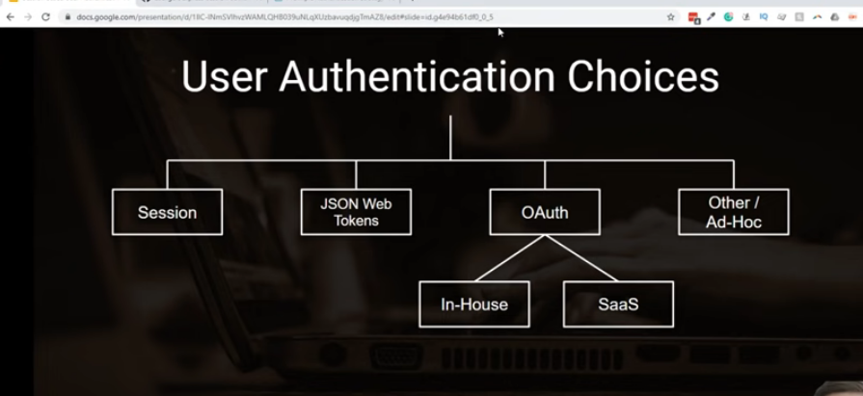

Slide 2
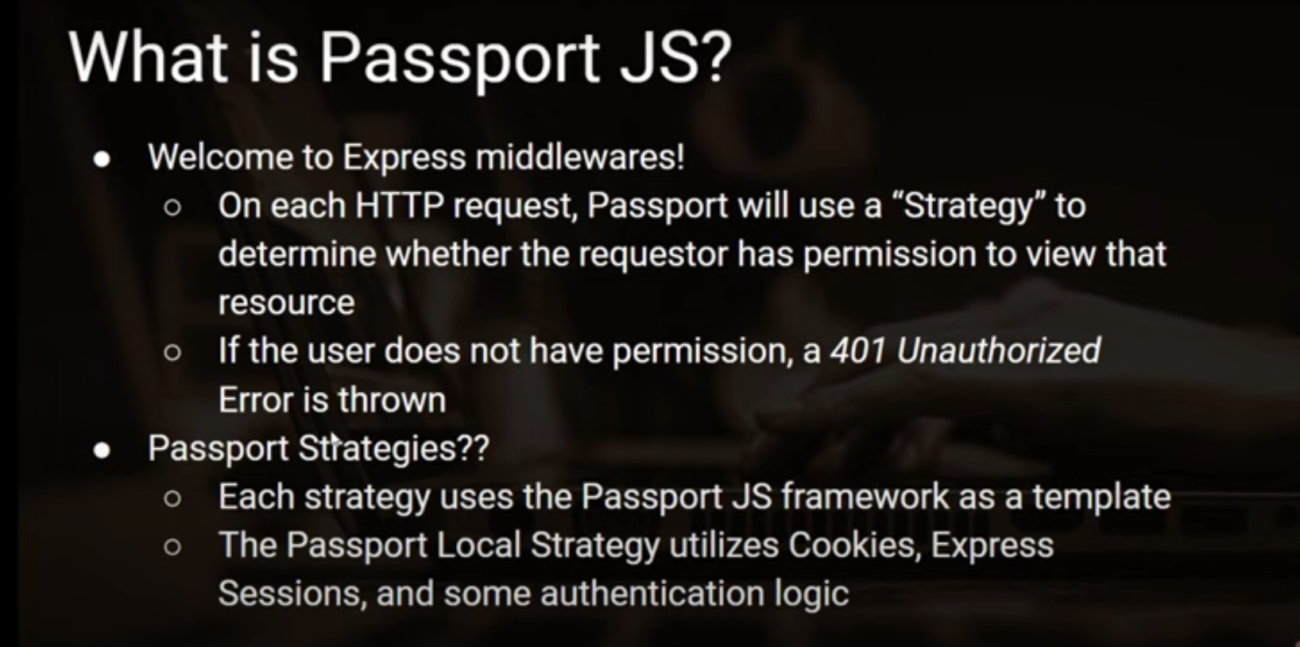

Slide 3
1. client make req
2.

Slide 4
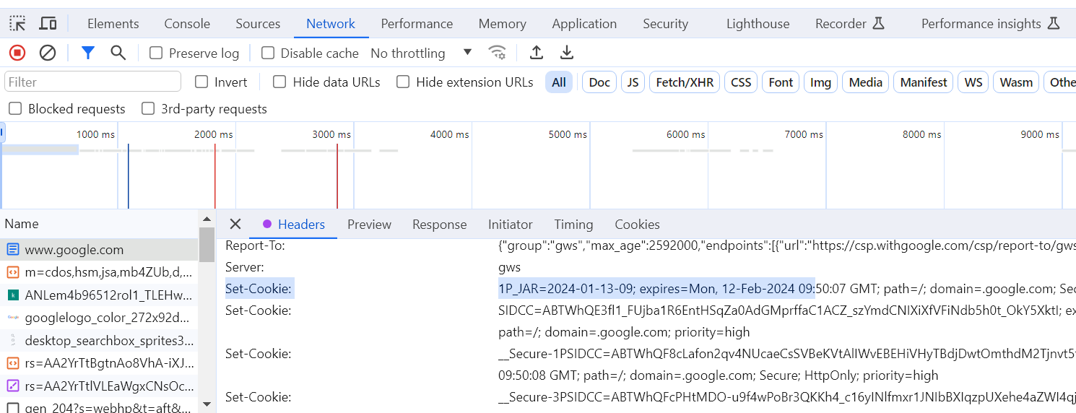

Slide 5
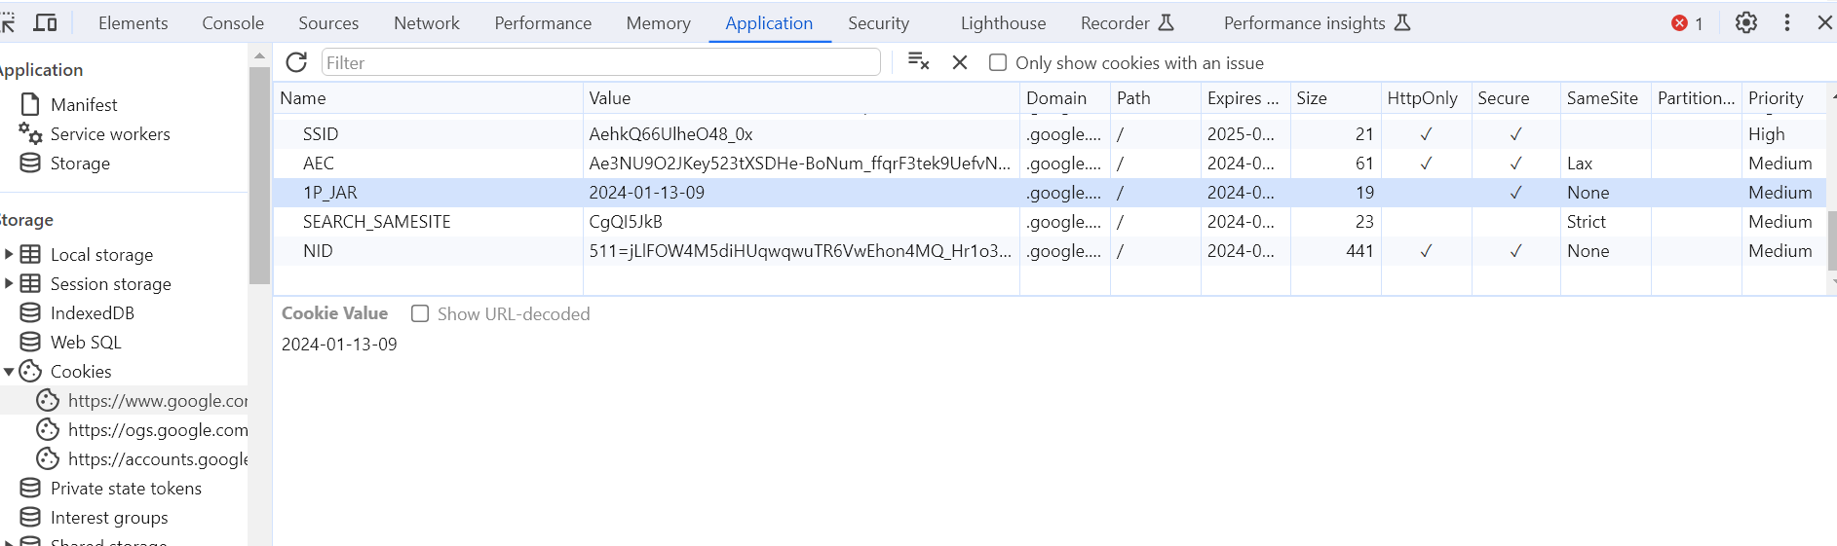

Slide 6
Request header fir cookie bhejega cookie storage se fetch kark

Slide 7
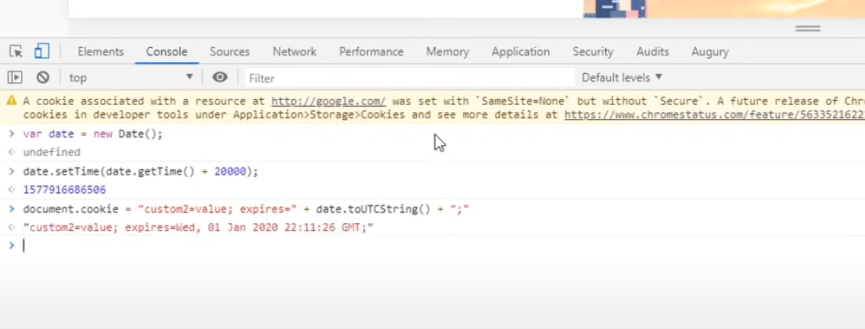

Slide 8
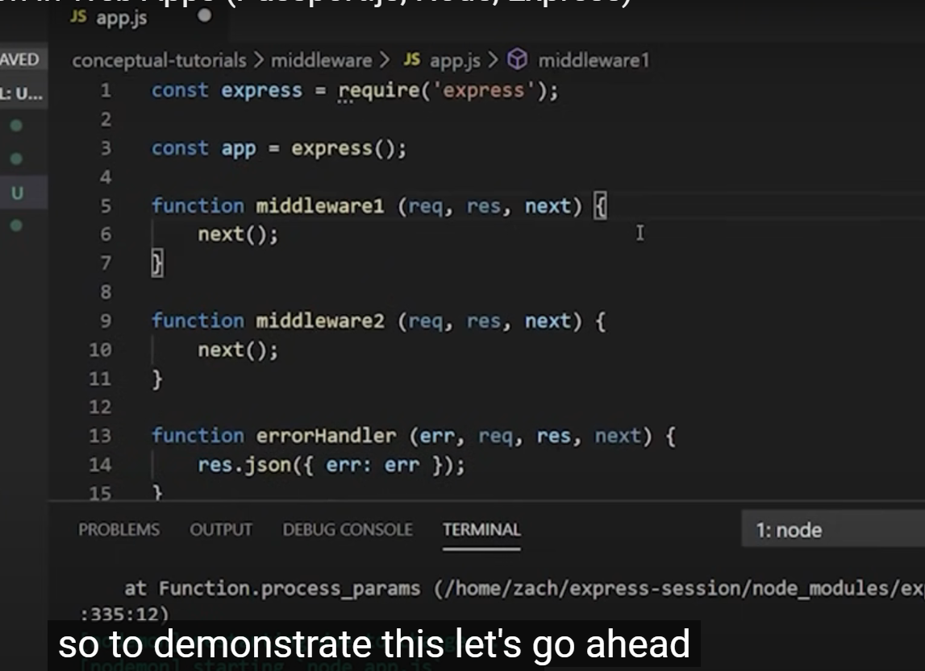

Slide 9
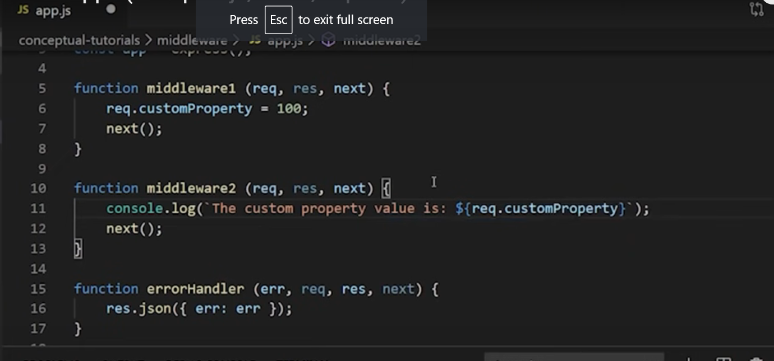

Slide 10
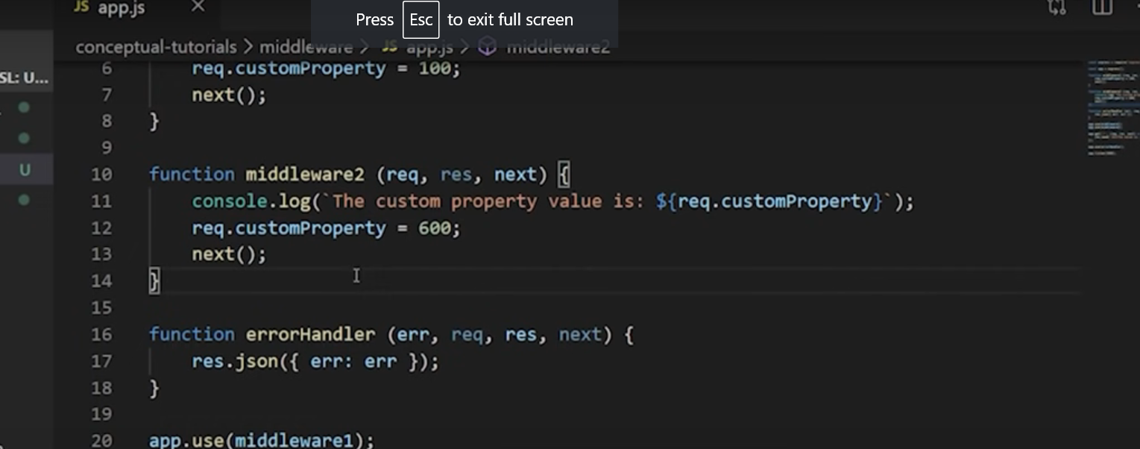

Slide 11
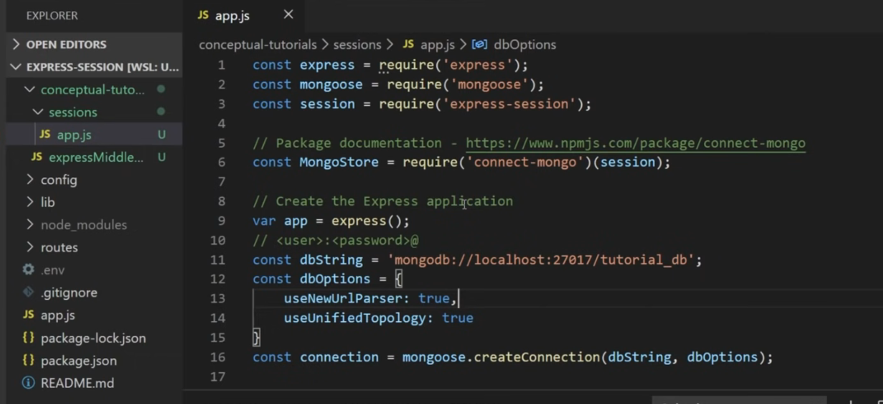

Slide 12
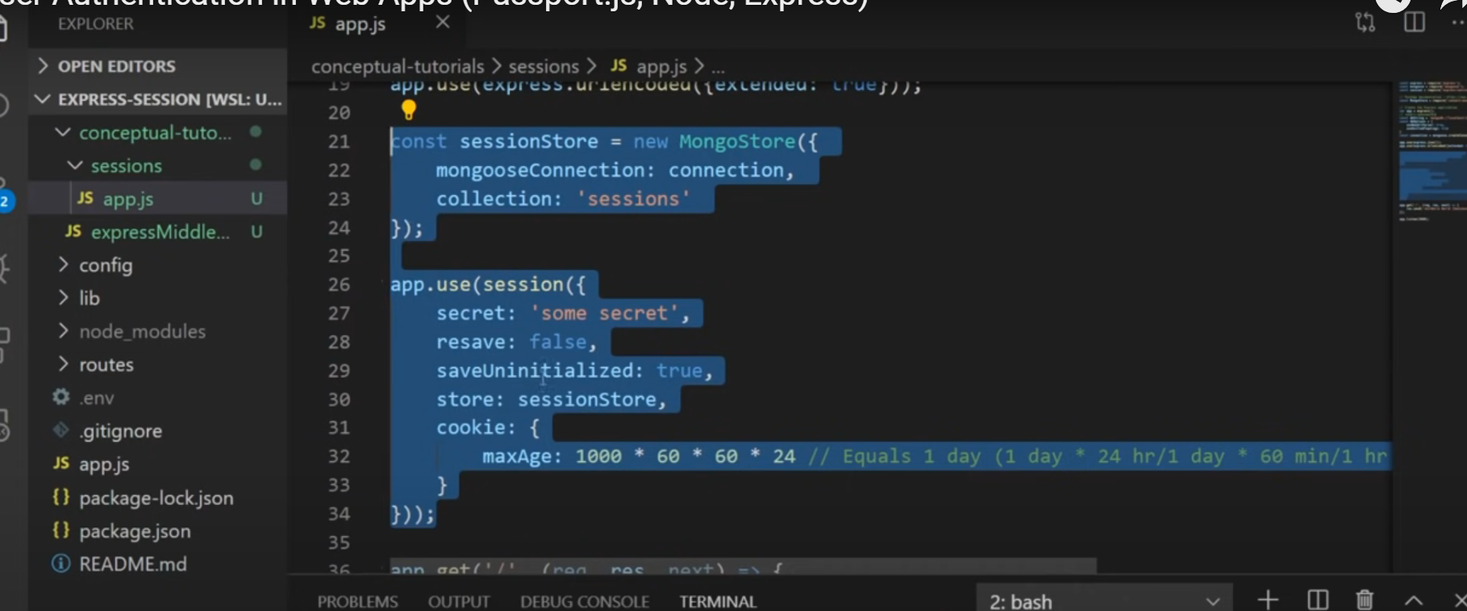

Slide 13
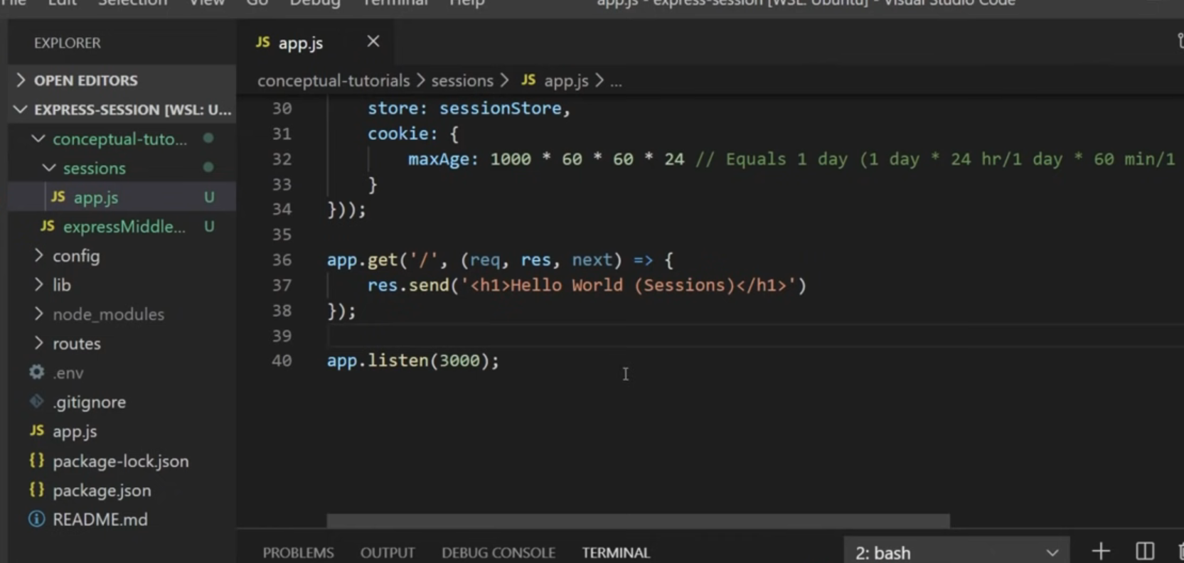

Slide 14
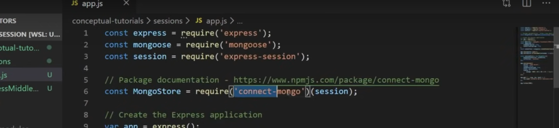

Slide 15
We are using mongo database for our session storage

Slide 16
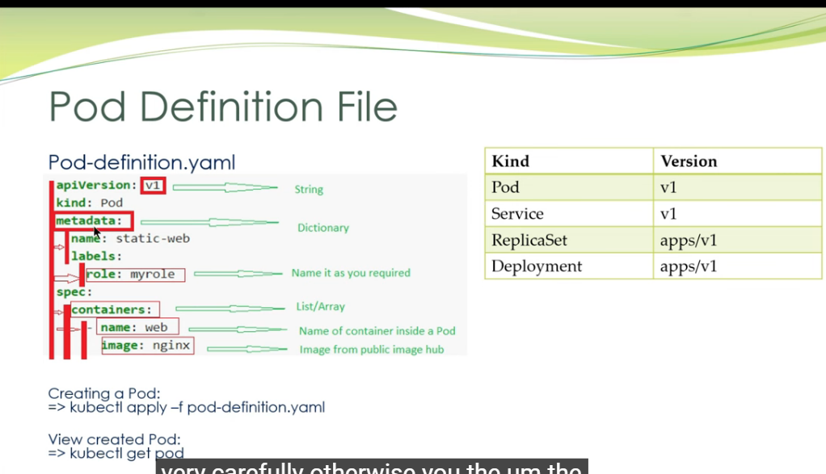
Part 1

Slide 17
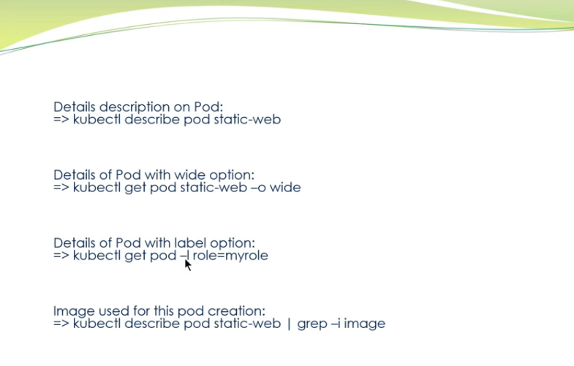

Slide 18
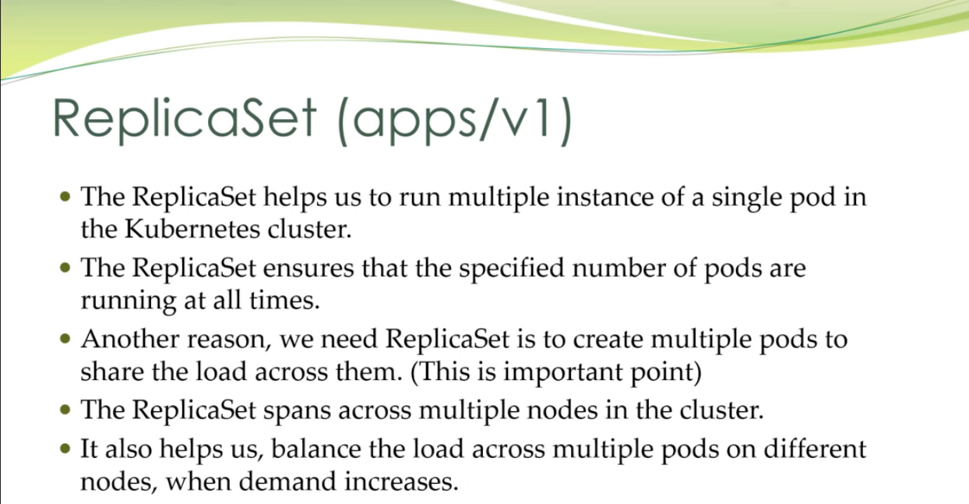
part2

Slide 19
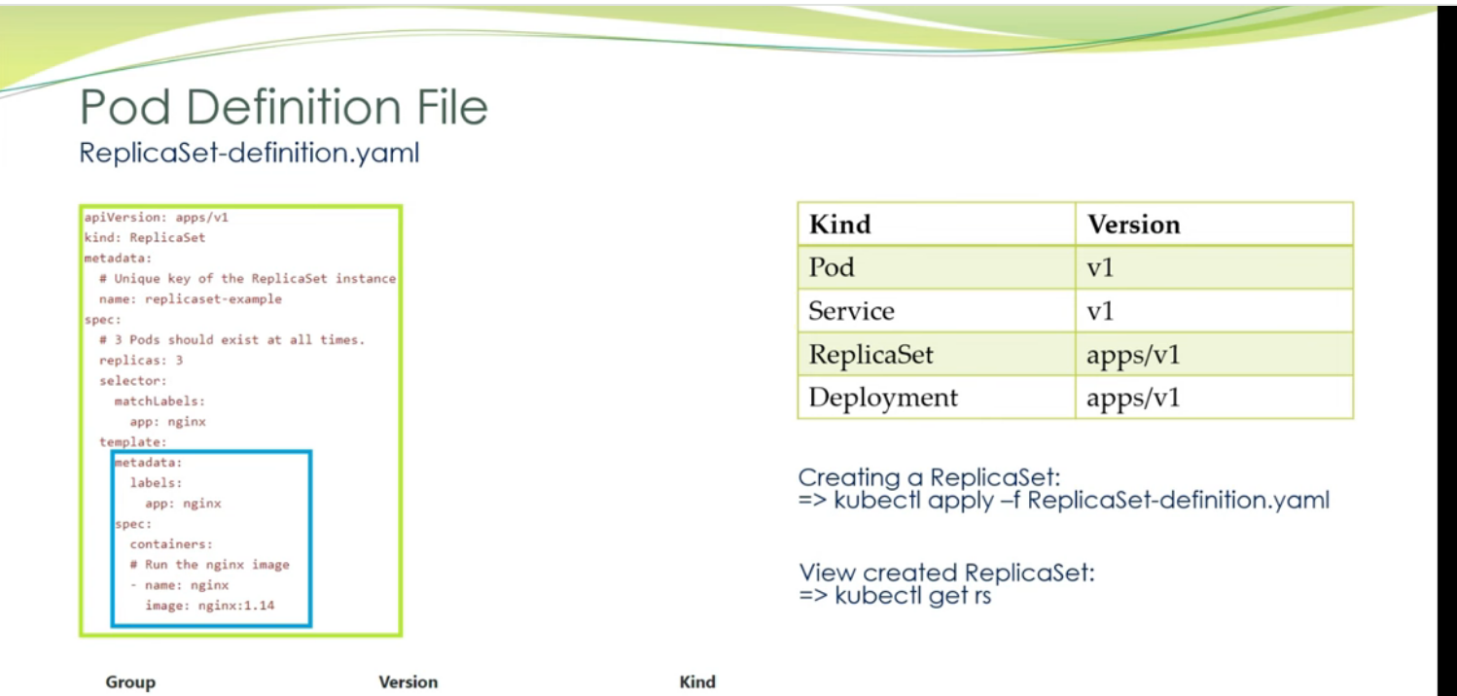
This replicaset having matchlabels app:ngnix so all the pods which having label as app:ngnix will be managed by this replicaset

Slide 20
Note template portion is same as pod defination

Slide 21
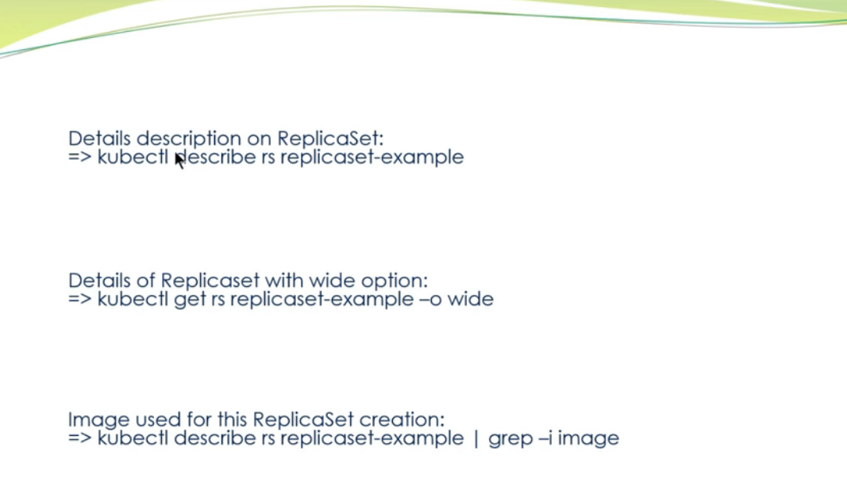

Slide 22
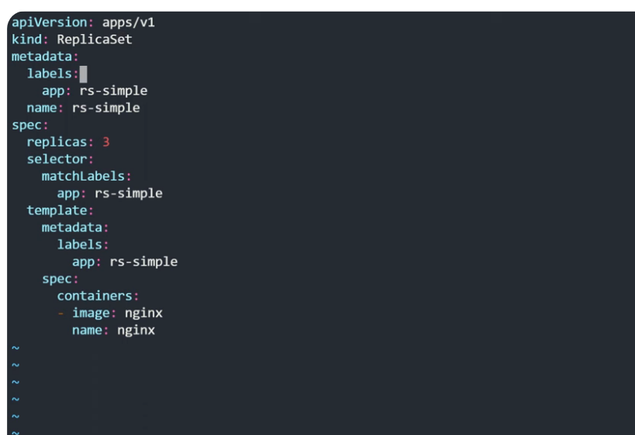
Replicaset using command
Change kind to replicaset

Slide 23
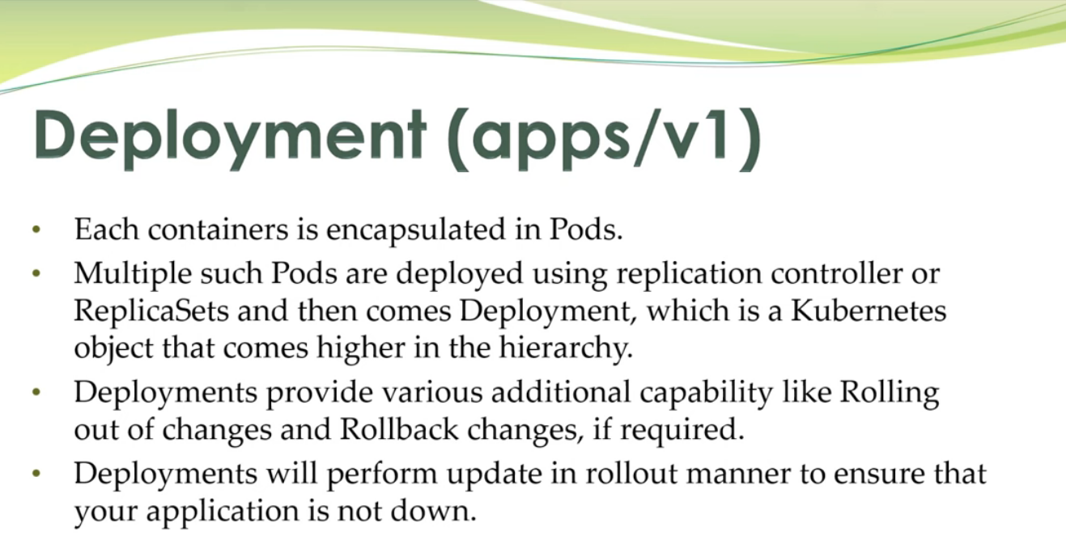
Part 3 deployment

Slide 24
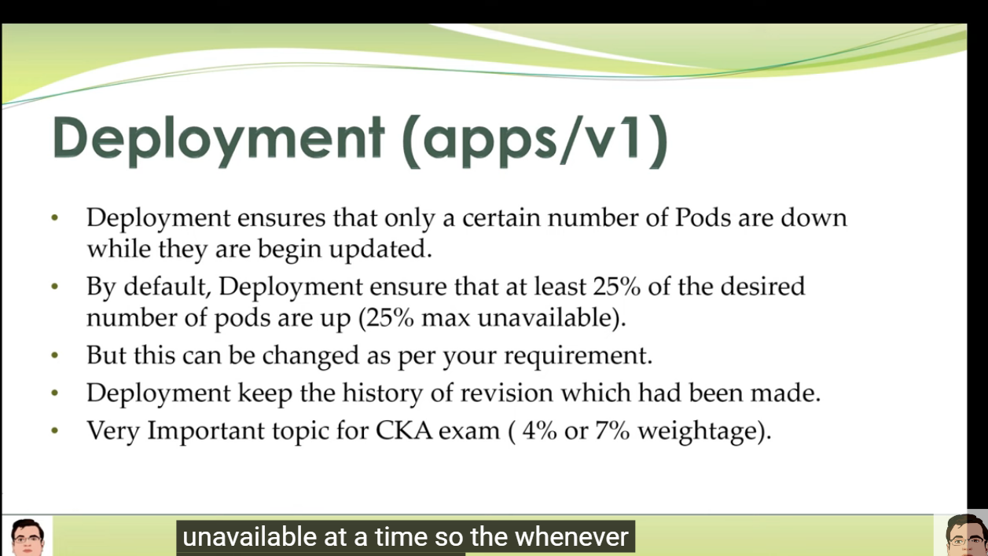

Slide 25
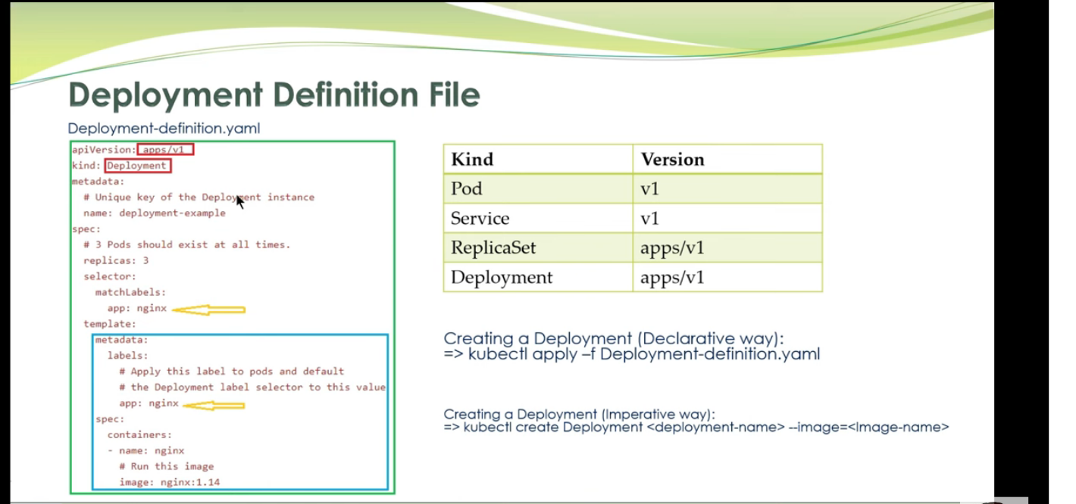

Slide 26
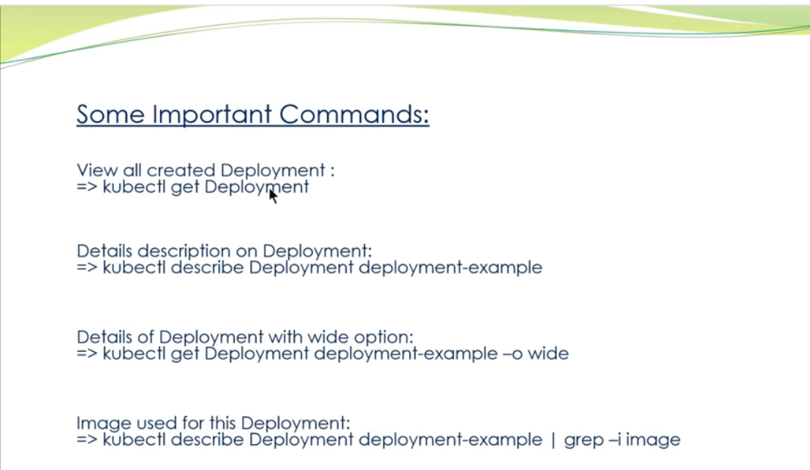

Slide 27
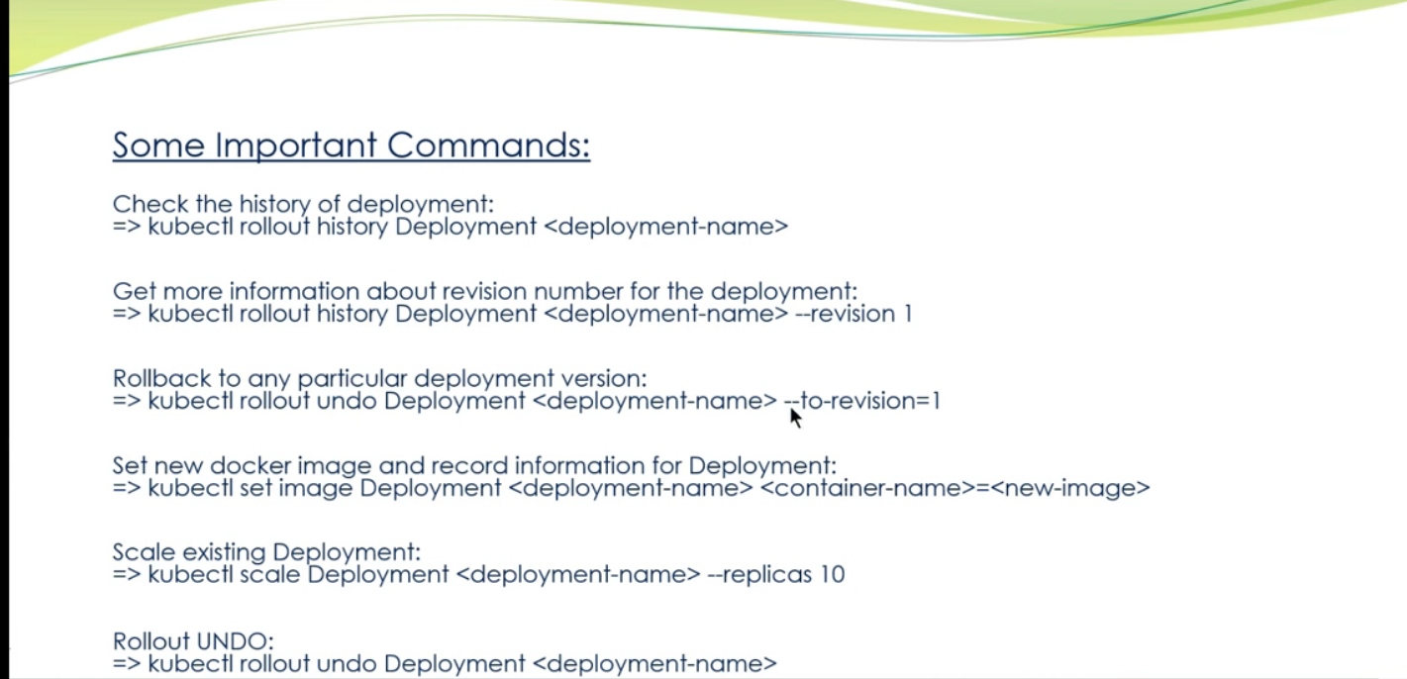

Slide 28
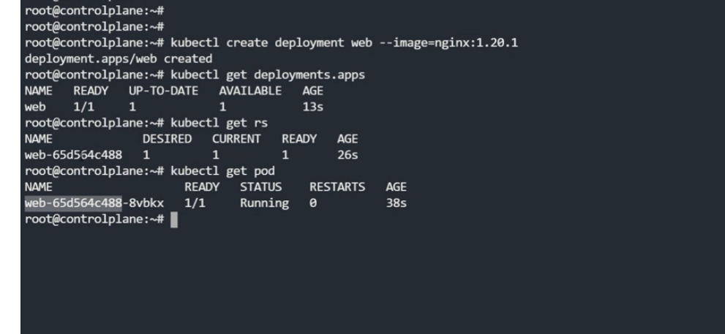

Slide 29
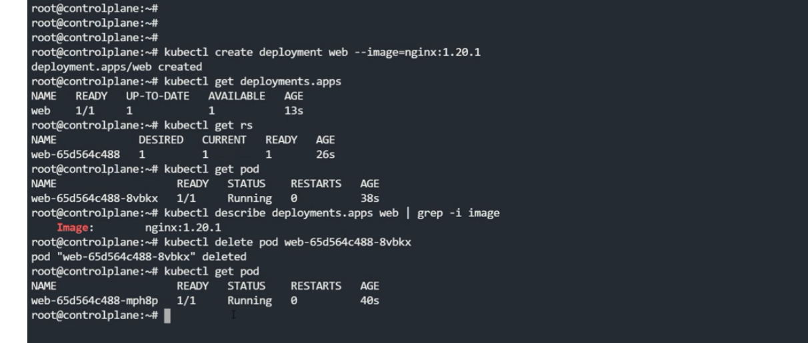

Slide 30
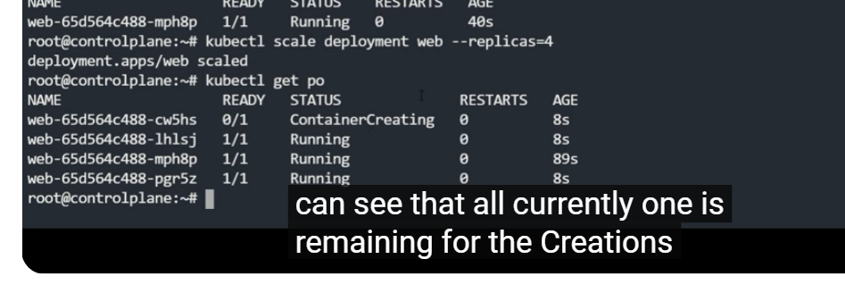
Scale up /increase relica set

Slide 31
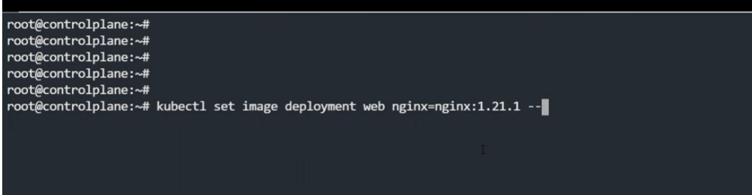
Setting image

Slide 32
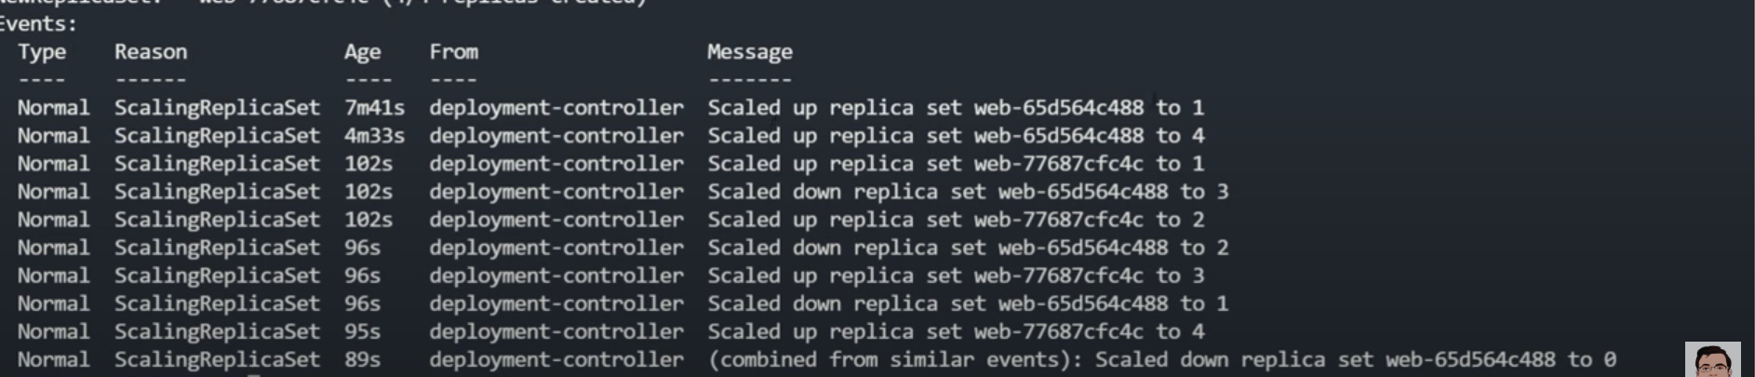
Show the history of deployment how deployment works in real

Slide 33
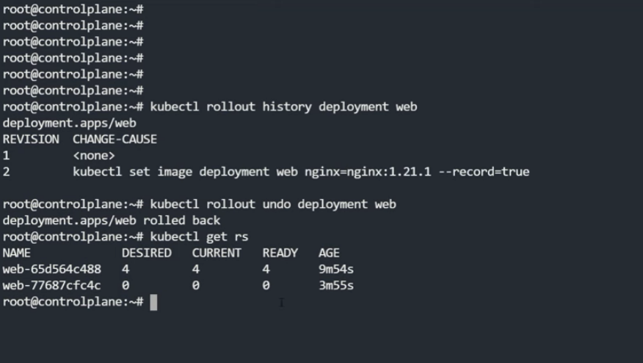
Checking history and rollback to older revision

Slide 34
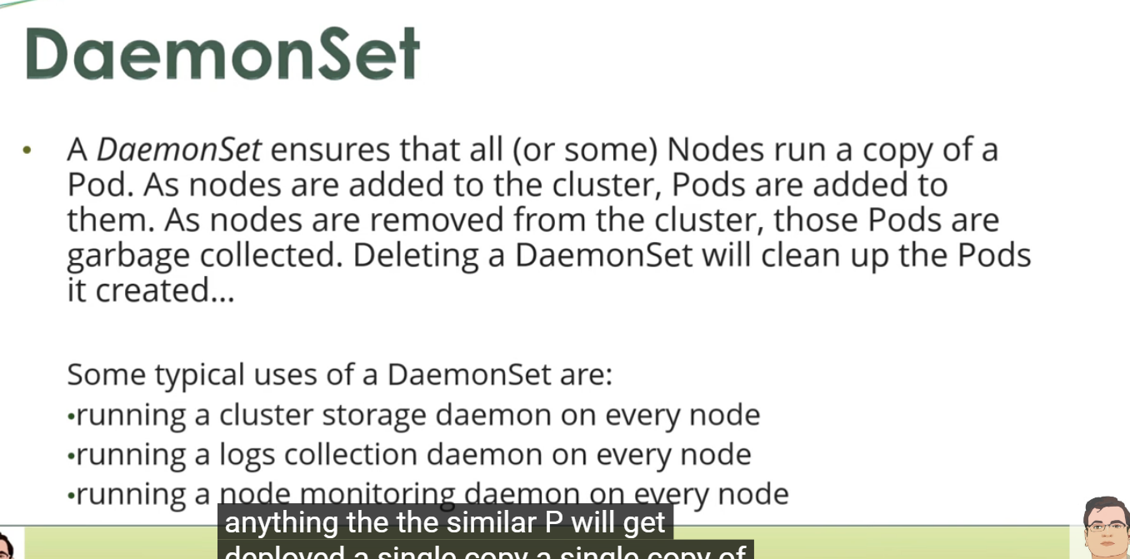
Part 4

Slide 35
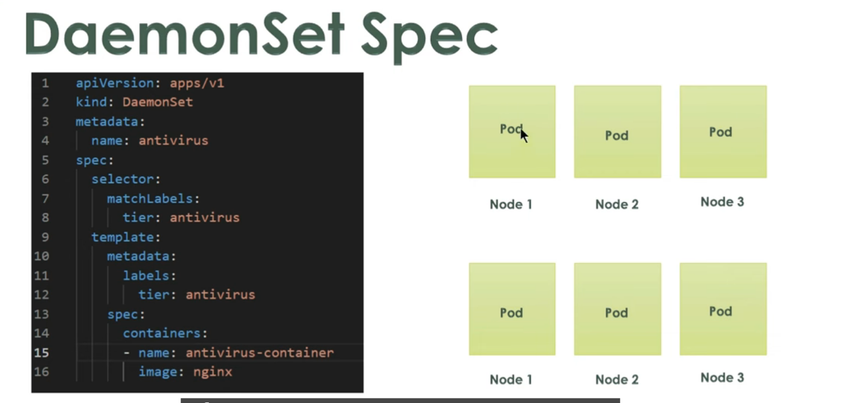

Slide 36
Apply this dameset
Damenset.yaml

Slide 37
Part 5
Label selector

Slide 38
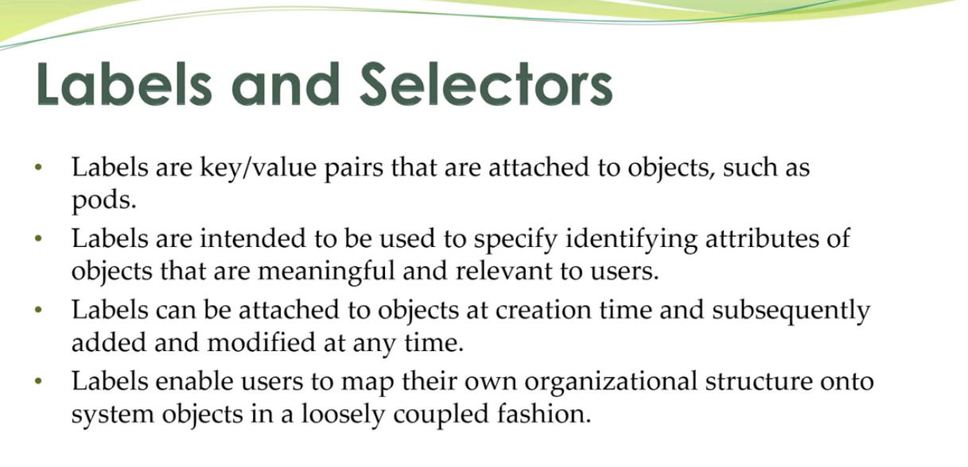
Part 5

Slide 39
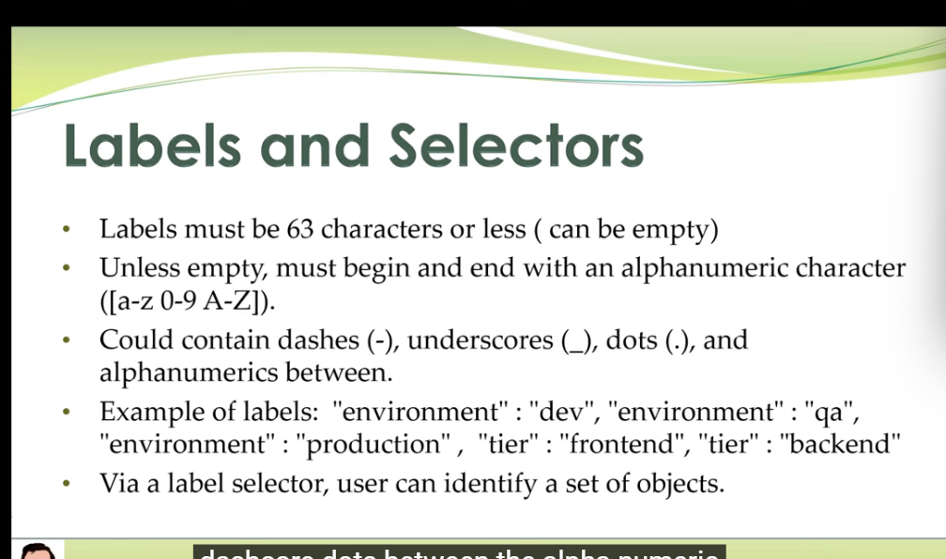

Slide 40
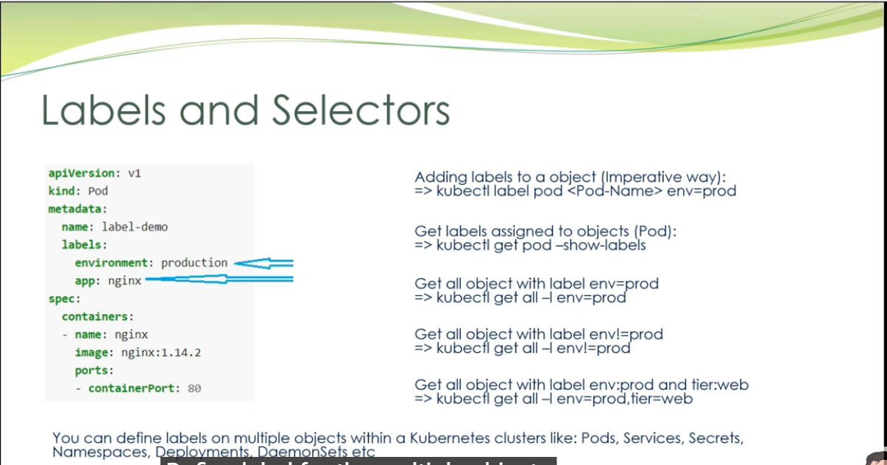

Slide 41
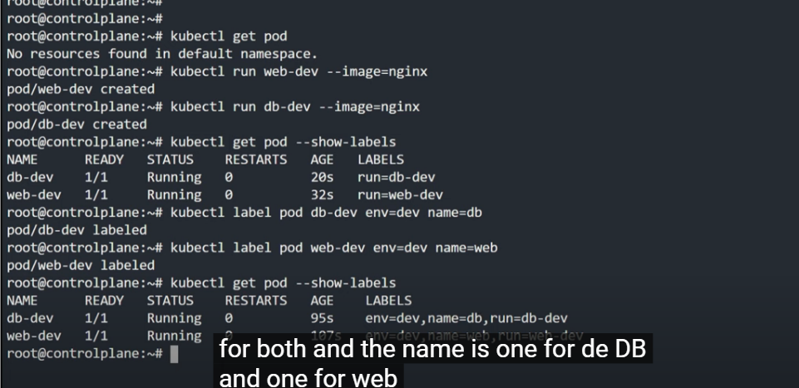

Slide 42
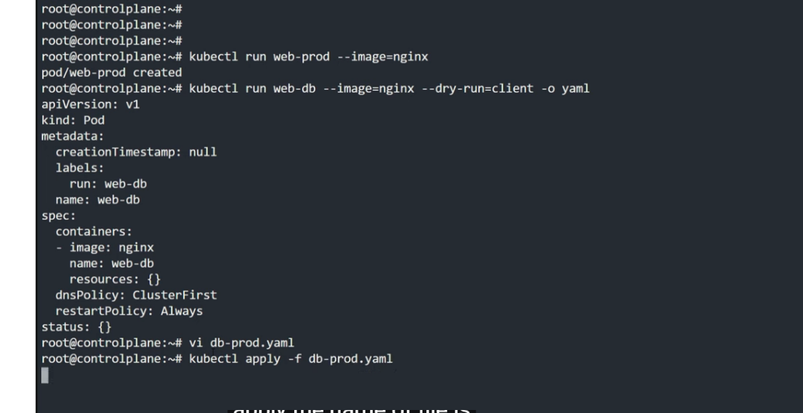

Slide 43
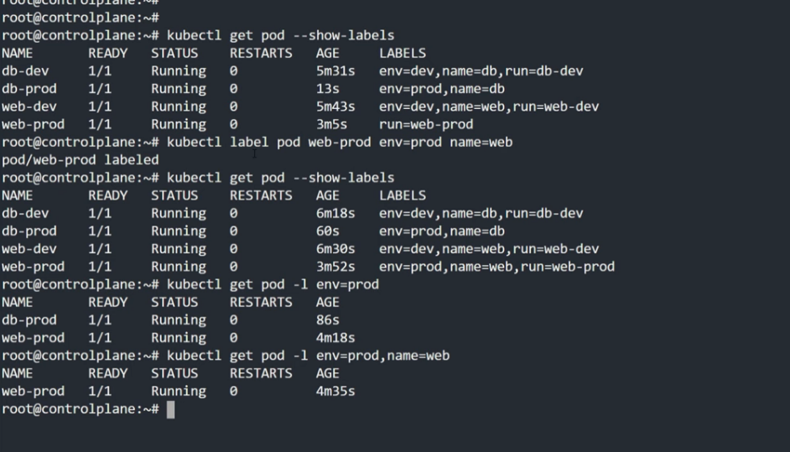

Slide 44
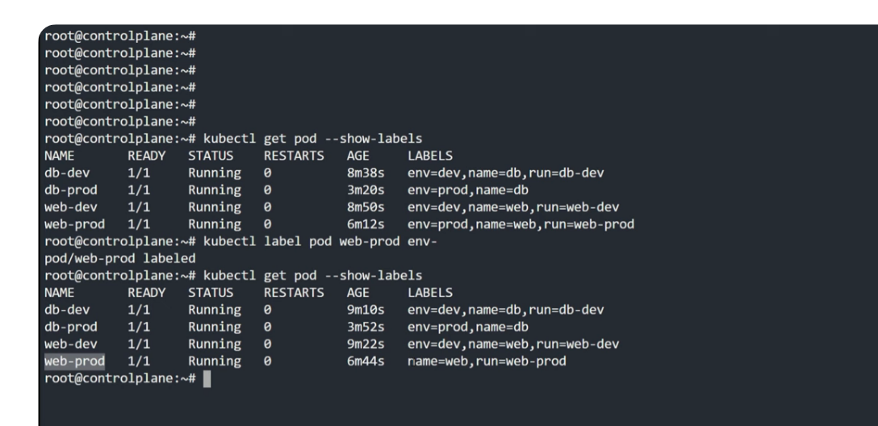

Slide 45
Part 6

Slide 46
Static pod

Slide 47
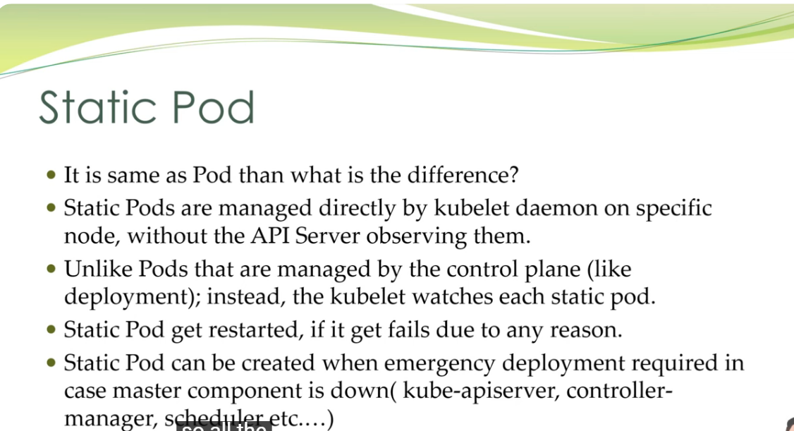

Slide 48
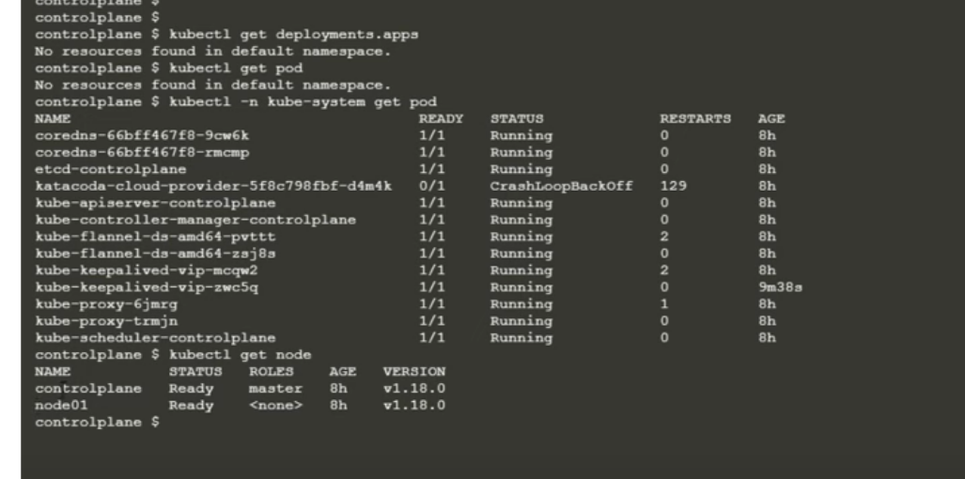
Etcd is running as static pod
Currently we have two node controleplane & node01

Slide 49
Any of the static pod running in controleplane master node have prefix of master node name

Slide 50
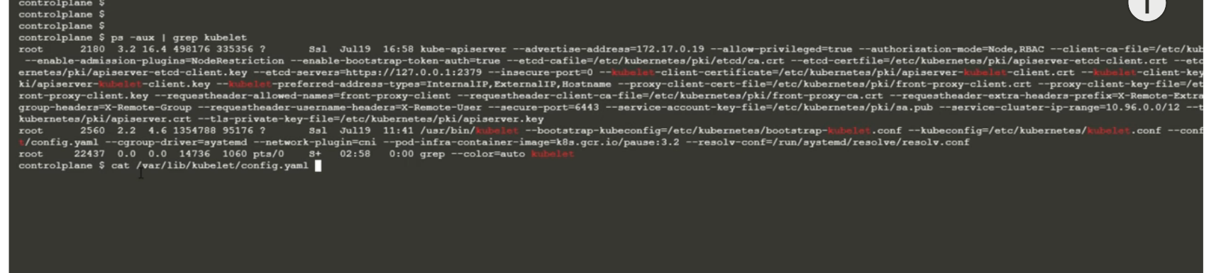

Slide 51
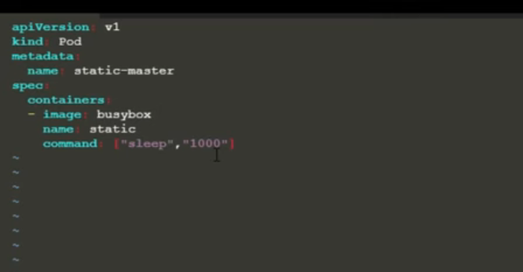
to create static pod in master node controleplane cd /etc/kubernetes/manifests vi static.yaml

Slide 52
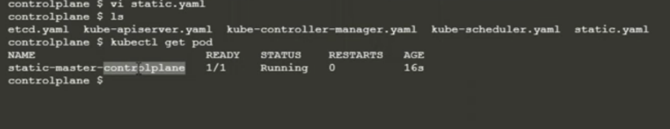
Sleep , 1000 we want container to sleep for 1000 s
So
Ek pod create ho jayega
Apply krne ki v jarurat nhi h
Kubectl det pod <pod-name> se delete nhi hoga

Slide 53
But we need to delete it directly static.yaml file

Slide 54
Graceful and Forceful Termination of Resource
Part 7
https://youtu.be/toLAU_QPF6o?si=Umv0gXmT1vZieqF-

Slide 55
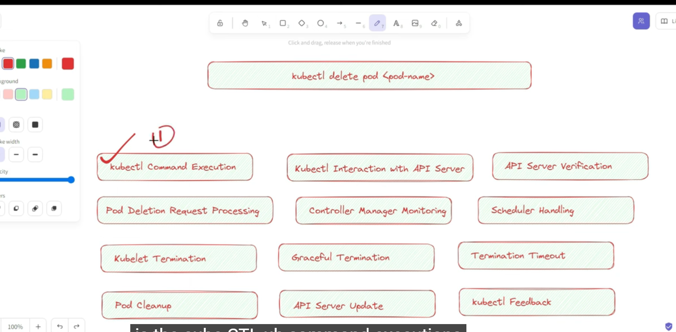

Slide 56
Part 8
NodeName and NodeSelector

Slide 57
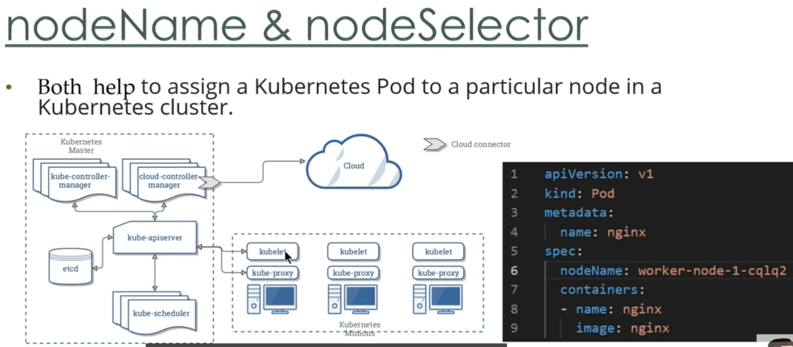

Slide 58
Is case me jha humne node specify kr Rakha h kube-apiserver –kubescheduler pr koi req nhi bhejega balki sari information regarding pod creation etcd db me save kr lega
After saving all the information
Kubeapi will contact kubelete of that particular node
Kublete will contact ci & that particular pod will get deployed into that particular node

Slide 59
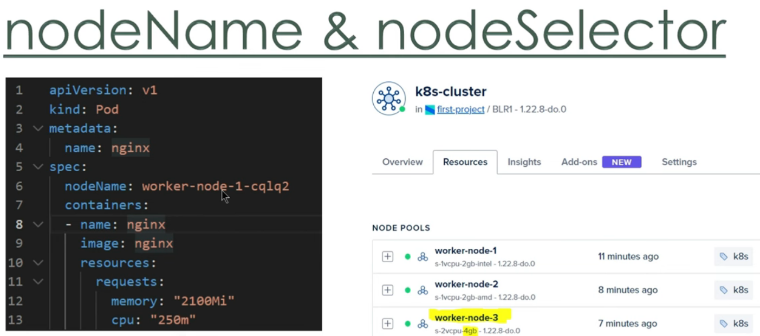
Here we are requesting resource with 2.1 memory for pod
If node01 don’t have that much of memory than we will get out of memory message or pending state

Slide 60
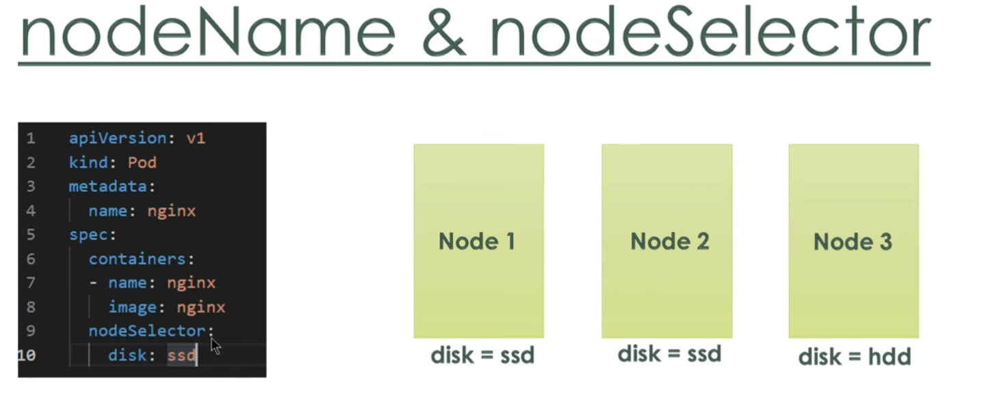
here we are having nodes with label as disk=ssd for Node1 & Node 2 & disk=hdd for node 3 this type of req will go through kube-scheduler

Slide 61
Kyki ab question h ki konse node me iss pod ko deploy kre
Aur nodes ko manage krne ka kaam kube-scheduler krta h

Slide 62
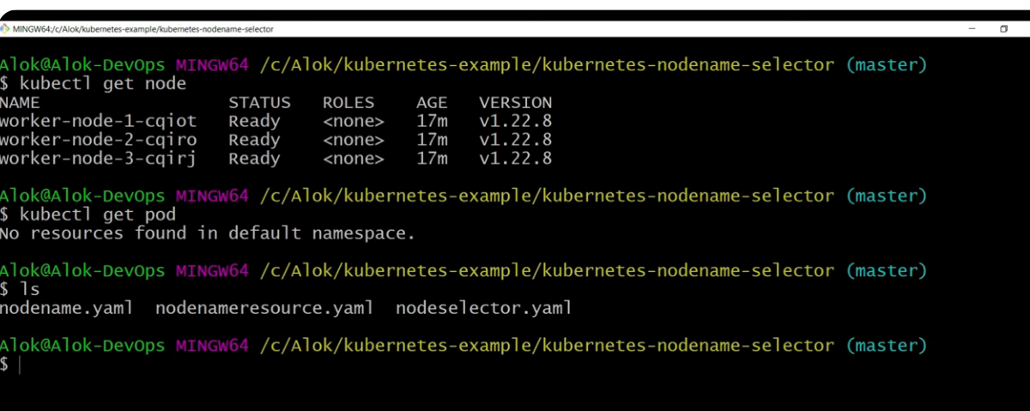
Create three worker node

Slide 63
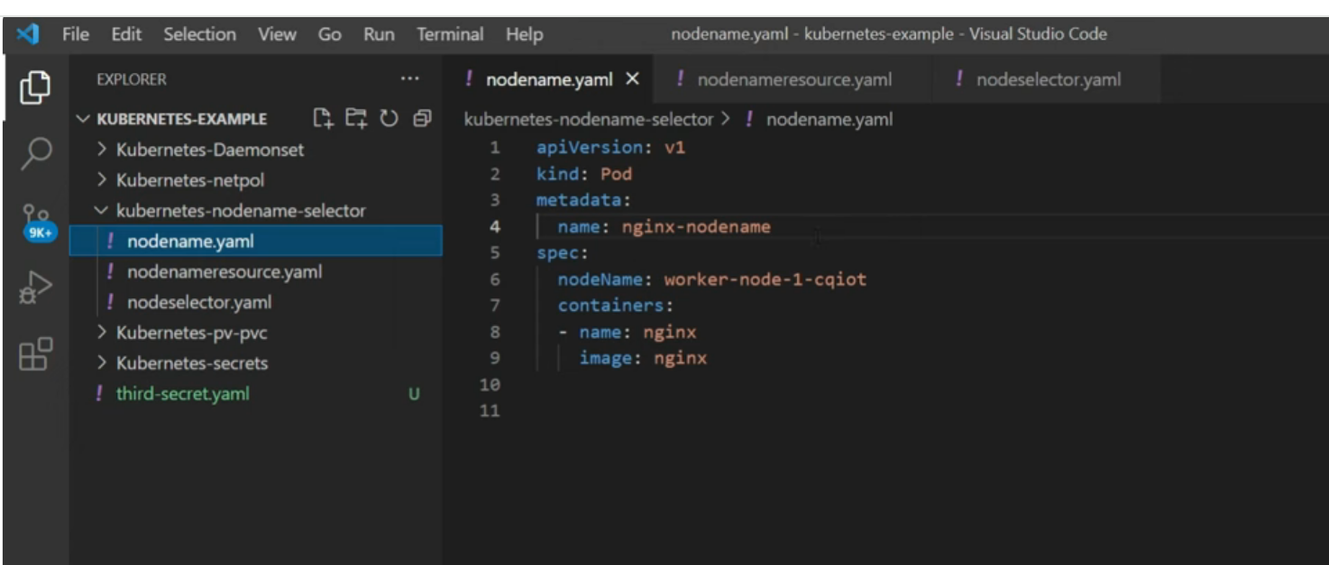
i). Deploying into particular node using nodename

Slide 64
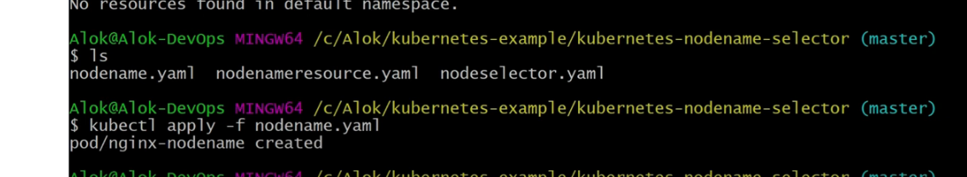

Slide 65


Slide 66
ii) Let us ask for more resourcse for particular pod to get deployed into particular node

Slide 67

Memory of node

Slide 68


Slide 69


Slide 70

iii).Deploy into node using label

Slide 71

By default k8s adds some labels to nodes

Slide 72


Slide 73
Part 9
Node affinity

Slide 74

Concept is same as node selector

Slide 75


Slide 76
Let say humare 100s node h aur humne 25% ko low , 25% ko medium
50% ko high label kr rkha h
Aur hum chahte h ki pod low wale me deploy na ho to we will use
Use
Operator: not
Values : low

Slide 77

Data encryption/ decreaption we are having streams of input data to enrypt it we using map whenever we are having 0011 replace it to 111000 same map can be used for decryption

Slide 78

Data compression

Slide 79

When internal buffer gets filled it will do write
Data is written to stream multiple time but at last it will be done once

Slide 80
Let say last chunk of data is 3000 bit instead of 2200 so 2200 is send to stream rest 800 bits will be send to ram

Slide 81

When buffer is filled then we have this on event

